Slide 1
Python API: Geometry
1. TiGL Workshop, September 11 / 12, Cologne
Martin Siggel + Jan Kleinert
German Aerospace Center

Slide 2
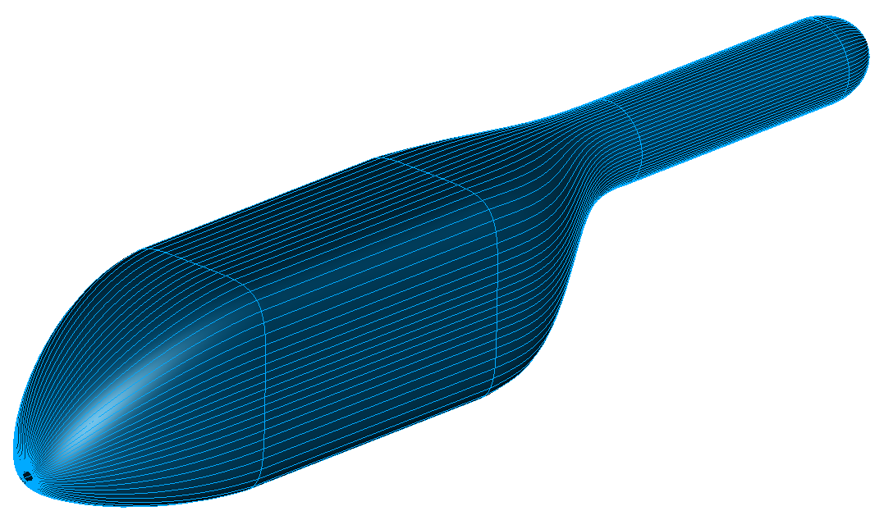
Motivation
We had different problems with the surfaces created by OpenCASCADE. Reasons are:
We used OpenCASCADE as a black box (we had no background in B-splines back then)
The resulting surfaces have sometimes bad quality
Not all modelling algorithms available that we needed
We started developing our own algorithms ☺
Even if you don‘t use CPACS oder TiGL‘s aircraft models, you can now use the algorithms in your own applications
We show you now how to do it!

Slide 3
Big Picture The shape creation process
Metadata: by TiGL
Named Shapes
Topology:
How do faces, edges belong together?
only OpenCASCADE
Solids
Shells
Geometry:
How do create curves and surfaces?
using new TiGL algorithms
or with OpenCASCADE
Surfaces
Curves
Points

Slide 4
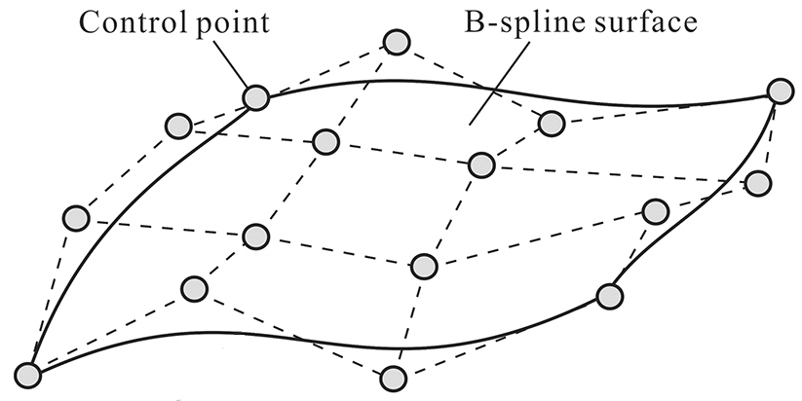
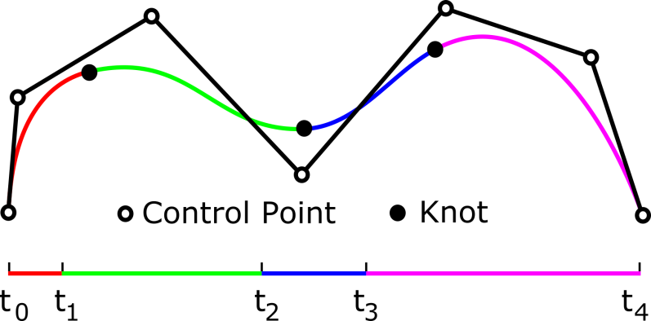


Bezier / B-splines / NURBS The basis for all geometry reprentations in OpenCASCADE
B-spline curve:
$$c\left(u\right)=\sum_{i=0}^{n}{P_{i}∗N_{i}^{d}(u, t)}$$
with:
Control points $\left\{P_{i}^{c}\right\}$
B-spline basis functions $N_{i}^{d}(u,t)$
Knot vector $t$, $t_{i}≤t_{i+1}$
B-spline surface:
$$s\left(u,v\right)=\sum_{i=0}^{n}{\sum_{j=0}^{m}{P_{ij}∗N_{i}^{d_{u}}\left(u, t_{u}\right)∗N_{j}^{d_{v}} (v,t_{v})}}$$

Slide 5
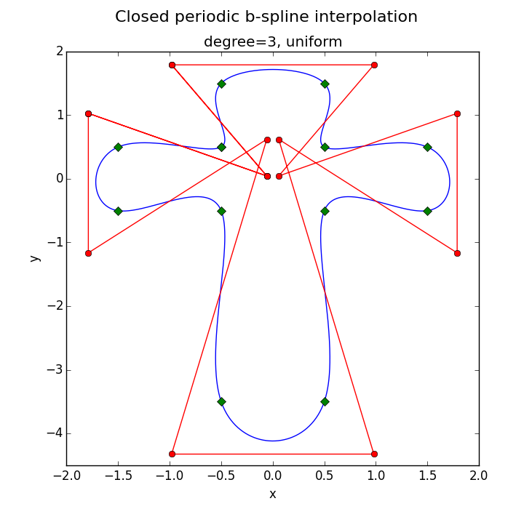
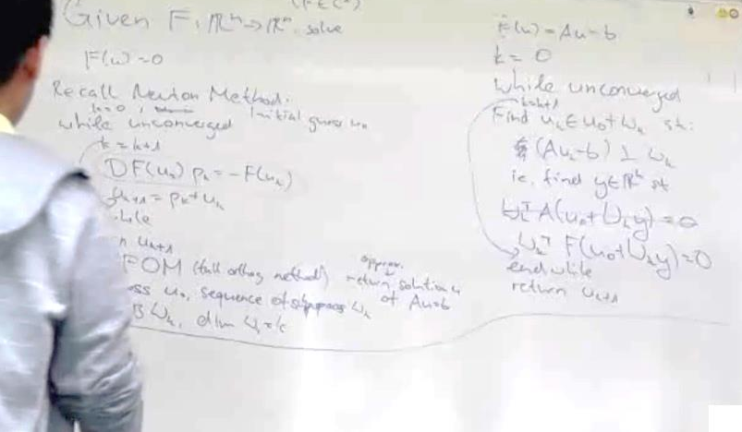

B-spline curve interpolation Or: PointsToCurve
Solve control points Pi, given data points Dj, such that:
$$\sum_{i=0}^{n}{P_{i}∗N_{i}^{d}\left(u_{j}, t\right)}=D_{j}$$
$$⇒Np≡d$$
i.e. the curve passes though the data points

Slide 6
Creating curves with TiGL Curve Factories
The package tigl3.curve_factories provides functions to create B-spline curves
B-spline Interpolation:
Even better: control at which curve parameter each point is interpolated!
import tigl3.curve_factories
# array of 3d points
points = [[0, 0, 0], [1, 0, 0], [1, 3, -1], [0, 0, 0]]
# create the curve
curve = tigl3.curve_factories.interpolate_points(points)
parameters = [0., 0.2, 0.7, 1.0]
# create the curve
curve = tigl3.curve_factories.interpolate_points(points, parameters, degree=2)

Slide 7
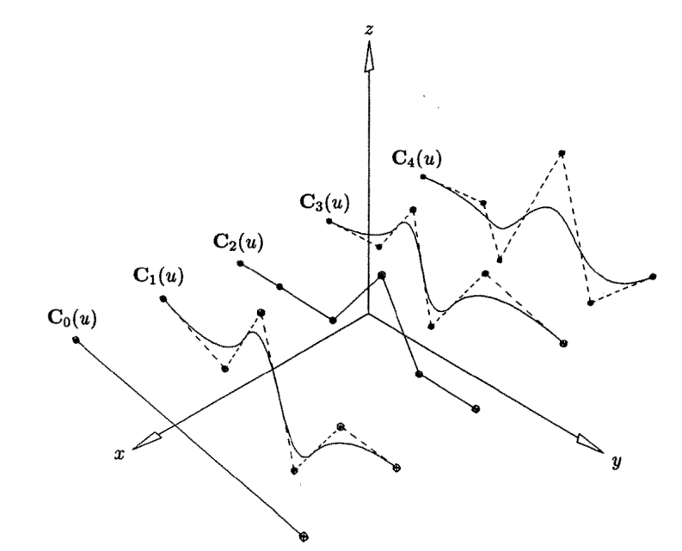
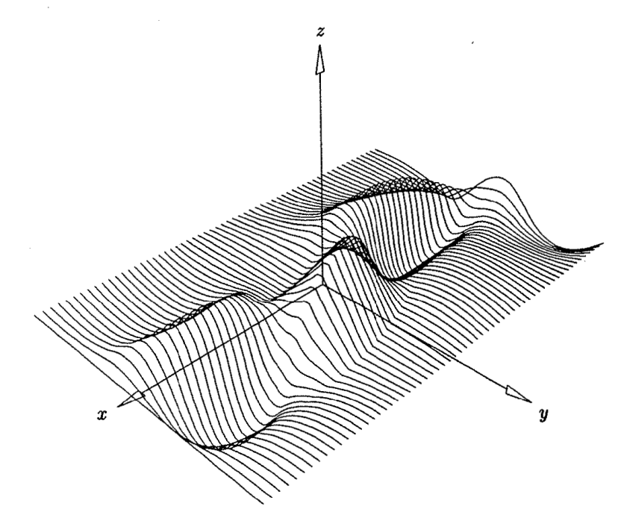


B-spline surface skinning Or: CurvesToSurface
Interpolates set of B-spline curves $c_{i}(u)$ by B-spline surface $s(u,v)$
Also involves solving multiple linear systems
$$s(u,v)$$

Slide 8
Creating surfaces with TiGL Surface Factories
The module tigl3.surface_factories provides functions to create B-spline surfaces
Skinning a set of curves:
Similar to curve interpolation – define a set of parameters at which each curve should be interpolated:
import tigl3.surface_factories
# create the surface
surface = tigl3.surface_factories.interpolate_curves([curve1, curve2, curve3, ... curveN])
parameters = [0., 0.333, 1.0]
# create the surface
surface = tigl3.surface_factories.interpolate_curves([curve1, curve2, curve3], parameters)
# or control the degree. degree=1 is linear lofting. Default degree is 3
surface = tigl3.surface_factories.interpolate_curves([curve1, curve2, curve3], degree=2)

Slide 9
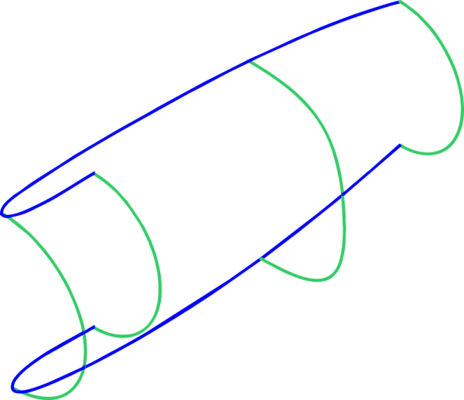
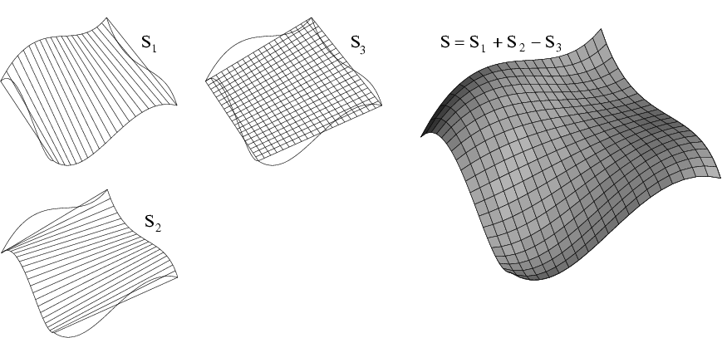
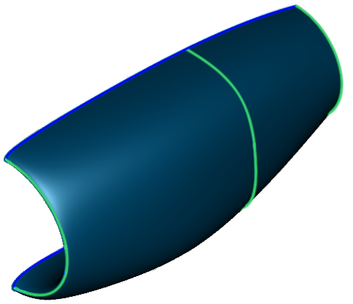






Gordon Surfaces Or: Curve network interpolation
Given network of profile and guide curves: Find surface that interpolates these curves
Profiles $f_{i}(u)$
$$S_{u}(u,v)$$
$$T(u,v)$$
$$G(u,v)$$
Guides $g_{j}(v)$
+
-
=
$$S_{v}(u,v)$$
$G(u,v)= S_{u}(u,v) + S_{v}(u,v) −T(u,v)$

Slide 10
Creating surfaces with TiGL Surface Factories
Interpolating a curve network (using the Merlin‘s Gordon Surface technique):
In theory: Profiles and Guides must all intersect each other exactly!
In TiGL:
Parameter spatialTol defines the maximum allowed distance between a guide and a profile
If they don‘t intersect exactly, the surface will be somewhere between both curves!
import tigl3.surface_factories
# interpolate the curve network of profiles and guides
surface = tigl3.surface_factories.interpolate_curve_network(
[profile1, profile2, profile3, ...],
[guide1, guide2, ...],
spatialTol=3e-4
)

Slide 11
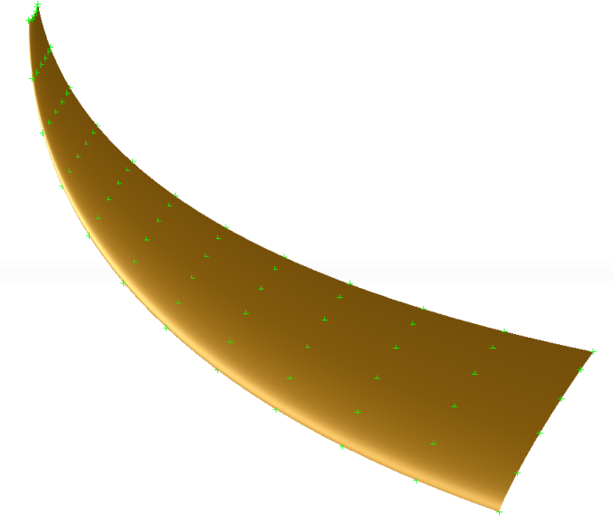
Other Geometry Algorithms in TiGL
B-spline approximation: Fit a curve to a set of points → tigl3.geometry.CTiglBSplineFit
B-spline representation of arbitrary analytical functions (e.g. How does the B-spline representation of CST curves look like?) → tigl3.geometry.CFunctionToBSpline
Hybrid B-spline approximation + interpolation of selected points → tigl3.geometry.CTiglBSplineApproxInterp
Interpolate a grid of points with a surface
→ tigl3.geometry.BSplineAlgorithms_points_to_surface

Slide 12
Remarks on programming with the geometry module
Geometric objects (curves and surfaces) are returned by a Handle
OpenCASCADE Handles are Smart Pointers that automatically free memory, when not needed
Unfortunately, this is still exposed in Python. We are working on it, to remove this from Python.
Whenever you e.g. get a Handle_Geom_BsplineCurve and you need a Geom_BsplineCurve, call its .GetObject() method:
Whenever you have e.g. a Geom_BsplineCurve and you need its Handle, call its .GetHandle() method:
b_spline = b_spline_handle.GetObject()
b_spline_handle = b_spline.GetHandle()

Slide 13
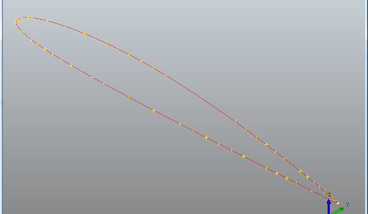
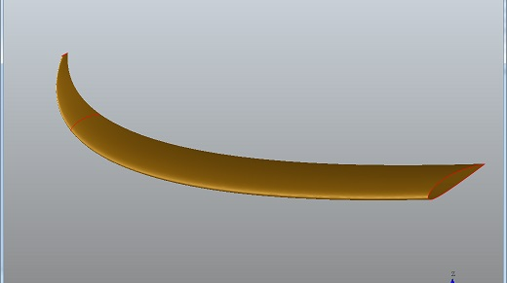
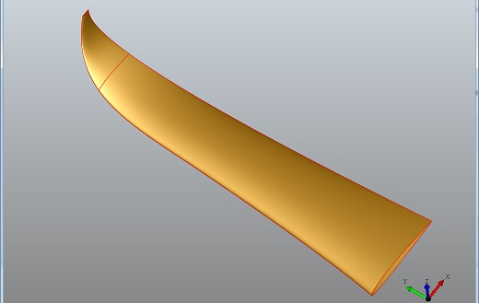
Excercise Geometry:
Goal:
Learn, how to use our geometry tools.
Tasks:
Create an airfoil by interpolating a list of points.
Use our geometry tools to skin multiple airfoils to create wing loft.
Use the curve network interpolation to create a wing loft with a custom leading edge.

Slide 14
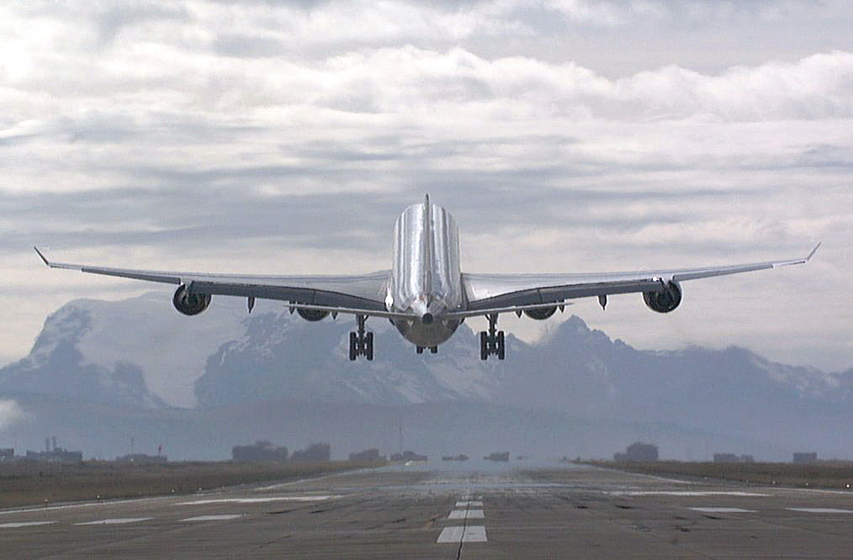
Questions?

